Slide 1
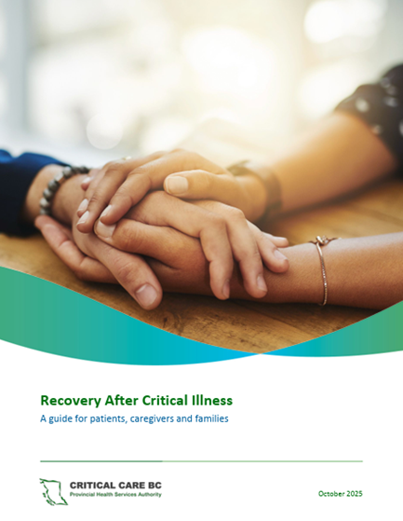
Recovery After Critical Illness Guide
Critical Care BC
March 2026

Slide 2

Why develop a
Recovery Guide?
We didn’t know what to look out for or when to reach out for more support – what’s normal, what’s concerning?
We weren’t told it would be this hard or take this long to recover.
We thought it was just us
We didn’t know I was at higher risk of readmission
Going Back to "Normal" After ICU Discharge Video – 10 min
Notes:
These are some of the statements we’ve heard through patient partner engagement and Critical Illness Recovery research over the last decade. This last statement here is key – We thought it was just us. That statement represents the profound isolation survivors and their families experience.
The link here is to a recent10 min JAMA film documenting the story of an ICU survivor who developed post-intensive care syndrome, or PICS. It features interviews with clinicians and researchers to explore what PICS is, what causes it, and ways to support patients & families.
Only FH had a Recovery Guide, and it needed to be updated anyway, so we did that work together as a province so we could all use the same resource.

Slide 3
What is PICS & PICS-Family
Post‑intensive care syndrome (PICS)
  persistent symptoms -physical, cognitive, and mental health impairments
    more than 50% of critical illness survivors develop at least one symptom of PICS.
PICS Family (PICS-F)
  mental health symptoms, such as depression and anxiety, that family members of a survivor may experience.
    Studies show that 30–70% of family members experience PICS-F symptoms.
    Can show up as extensive caregiver strain, often affecting employment, therefore finances, as they care for their loved one
Notes:
PICS – when symptoms are seen in one area, that can impact other areas – for example, if they mobility issues, that can affect their ability to get to social settings, which impacts their cognitive wellbeing and can lead to depression
PICS – 1 in 5 survivors exp anxiety, depression, symptoms of PTSD – higher % than combat veterans returning from Afghanistan

Slide 4
What difficulties can patients experience?
ADLs are harder - dressing, washroom, hygiene, medication, driving
Challenges processing daily events/activities
Difficulties scheduling appointments, getting to them, or even recognizing they need one
Feel isolated, alone, depressed
Many can’t return to work – weeks to years after discharge
Profound overwhelm… daily, for weeks to years
Relationship challenges
Struggle accepting their ‘new Normal’
Notes:
Regarding the last bullet – Family can have difficulty understanding why their loved one continues to have challenges with basic things they were independent with before their critical illness – ‘why can’t you dress yourself yet? why are you so forgetful still? why haven’t you returned to work? – you’ve been discharged from hospital for almost a year now’
…Patients and families are often discharged from hospital thinking they’ll be back at their pre-illness level within a few days or weeks, and struggle to understand this ‘old normal’ doesn’t exist anymore.

Slide 5
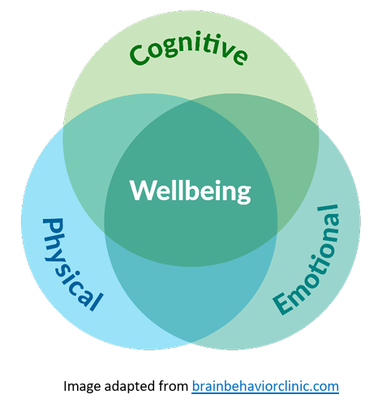
Purpose of the Guide
Helps patients & families understand physical, cognitive, emotional, and practical recovery
Helps patients & families prepare for their recovery journey
Provides consistent, evidence informed information across BC
Northern Health CC Recovery Program – 7 min video for patients and families
Notes:
Explain why consistent information matters – one provincially developed document is more sustainable and P&F hear the same information from every clinician.
Highlight variation across BC – some HAs had no resources to support P&F after discharge; we can now share the resources to reduce duplication in the system and have one ‘source of truth’
Emphasize emotional burden families face – 1 in 4 people in BC are informal, unpaid, unrecognized family caregivers with challenges of their own, sometimes including the inability to return to work and leave their loved one unsupervised – financial strain, hard on their relationships and resilience over time.
The video is for the NH CC Recovery Clinic, but it highlights what the recovery process may look like. It’s included in the Recovery Guide

Slide 6

When to Introduce It
Once survival is expected
During CC-to-inpatient unit transfer
During hospital discharge teaching
When caregivers express uncertainty
Before follow‑up or virtual check‑ins
At GP/NP visits in community
MS Copilot generated image
Notes:
During teaching, encourage staff to think of examples from local practice where they recognized discharge information would have been helpful – we all have experience with readmitted patients where it was obvious they were not prepared or didn’t have the resources to thrive. Suggest integrating review of this Guide into standard discharge checklists.

Slide 7
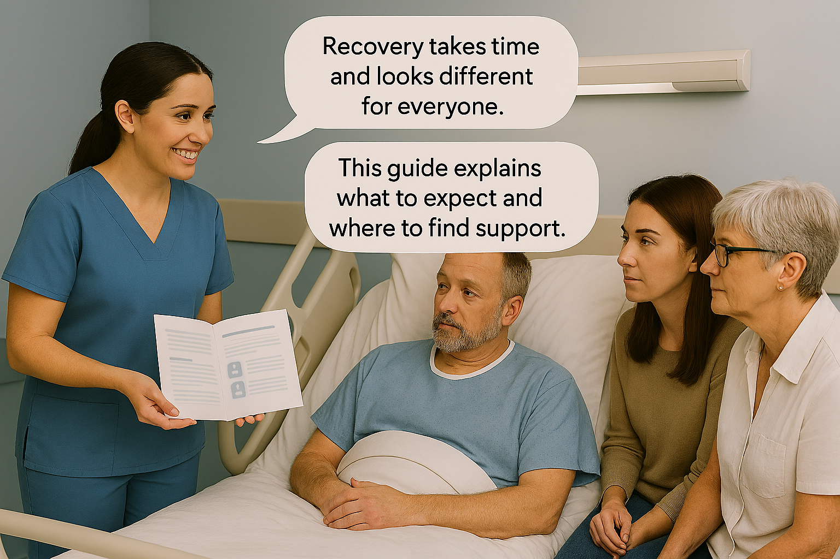
Plain‑Language Script
Avoid medical jargon
Check in often during review with patients and families
The Guide has purposefully been developed with language at a Grade 8 level
  Consideration for preadmission SDOH
MS Copilot generated image
Notes:
Coach staff on tone—warm, slow, empathetic. Repetition, across all staff is key

Slide 8
Key Points to Highlight
Recovery is not linear—good days and hard days
  Encourage patients and families to accept help when it’s offered
Expected vs concerning symptoms
  Expected: Gradually improving symptoms over weeks–months.
  Concerning: New, worsening, or functionally impairing symptoms at any stage.
  Immediate red flags: suicidal ideation, acute confusion, respiratory distress, new neurological deficits.
BC-wide supports & resources available
  Caregiver guidance & support
Notes:
Before sharing what’s on the slide for the 2nd bullet, ask staff to share some expected symptoms and concerning symptoms. (Animations have been added to delay display of bullets 2 and 3.
Emphasize caregiver inclusion during review of the Guide at the bedside.
R/t last bullet – see next slide

Slide 9

Caregiver guidance & support
Family Caregivers of BC offers free, compassionate support across the province
A toll-free Caregiver Support line: 1-877-520-3267
1:1 coaching with trained staff
Peer support groups to connect with others
Free webinars and tools to help you navigate caregiving and the health system
Video (2:45) https://youtu.be/3MeTrHQnHag?si=4n0JmSpAHu9VBUVf
Notes:
Highlight that ~80% of health care after hospital discharge is provided by families/caregivers – unpaid, unrecognized.
Please offer referral to FCBC – free province wide support for families. Funded by MoH.
Their trained staff do ALL the work of assessment and support.
Early referral is best, before they burn out and are too tired to connect with support – their team hears from caregivers that this is an issue.
Highlight how this service may help reduce caregiver fatigue and possibly prevent readmission to hospital.
The Recovery Guide is also available to GPs/NPs supporting survivors and their families in the community – through Pathways BC, which is a database of resources they can access for patient facing resources.

Slide 10
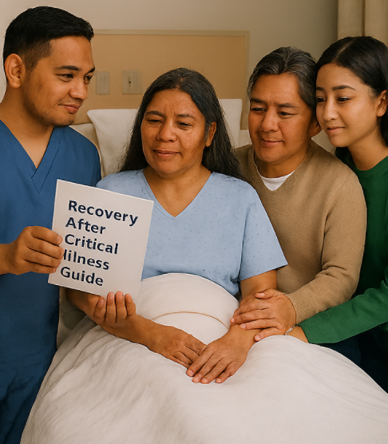
Teach‑Back Prompts
Teach‑back is not a test of the patient and family—it's a test of our clarity and their understanding.
In your own words, what stands out for you?
What changes do you expect in the coming weeks and after discharge from hospital?
What symptoms would make you see your community health nurse, doctor, or seek emergency medical attention?
MS Copilot generated image

Slide 11
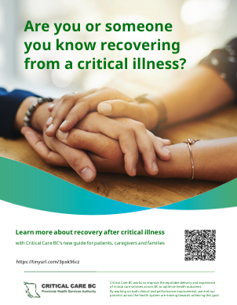
Tips for Effective Use
Offer print or digital copies
Display the QR poster
Highlight key pages
Encourage family/caregivers to review
Most effective if reviewed frequently throughout the trajectory of care
Education about PICS/PICS-F is required for med/surg, rehab & community health staff
Notes:
Encourage sites to place QR code poster in visitor lounges. Mention digital equity considerations – QR code and URL for those who don’t have a smartphone?
This Guide is available as a resource for GPs/NPs supporting patients in the communities, through Pathways BC, an online database of patient resources and quick references for GPs/NPs.

Slide 12
Repeated, evidence informed information is shown to be the most helpful to patients and families.
Builds trust
Reduces uncertainty
Improves satisfaction
Clinician benefits of consistent information
Standardized messaging
Interdisciplinary ownership
Increased agency to provided needed support
MS Copilot generated image
Notes:
Anticipated questions from staff:
Where can we find the Guide to review with Patients and Families? – explain unit/site process
What disciplines share responsibility for reviewing the guide?
SW, RN, RTs for resp info, PT/OT for mobility info, dietitians for diet info, Discharge Liaisons, GPs/NPs and AH once discharged to community
MDs can reinforce with P&F, remind staff that the Guide should be reviewed – they can too if feasible

Slide 13
References
NICE. (2009). Rehabilitation after critical illness in adults (Clinical Guideline 83). National Institute for Health and Care Excellence. (Last surveillance review 2018.)
Dean, E. A., Biehl, M., Bash, K., Weleff, J., & Pozuelo, L. (2021). Neuropsychiatric assessment and management of the ICU survivor. Cleveland Clinic Journal of Medicine, 88(12), 669–679.
Haines, K. J., Sevin, C. M., Hibbert, E., Morello, R., Edbrooke, L., & McPeake, J. (2019). Key mechanisms by which post‑ICU activities improve in‑ICU care: Results from the international THRIVE collaboratives. Intensive Care Medicine.
Leppin, A. L., Gionfriddo, M. R., Kessler, M., et al. (2014). Preventing 30‑day hospital readmissions: A systematic review and meta‑analysis of randomized trials. JAMA Internal Medicine, 174(7), 1095–1107.
Hesselink, G., Sir, Ö., Koster, N., et al. (2021). Teach‑back of discharge instructions in the emergency department: A pre–post pilot evaluation. Emergency Medicine Journal, 39, 139–146.
National Confidential Enquiry into Patient Outcome and Death (NCEPOD). (2025). Recovery Beyond Survival: Recommendations for rehabilitation after critical illness.
Jones, C., Bäckman, C., Capuzzo, M., et al. (2010). Intensive care diaries reduce new‑onset post‑traumatic stress disorder following critical illness: A randomized, controlled trial. Critical Care, 14, R168.
Garrouste‑Orgeas, M., Flahault, C., Vinatier, I., et al. (2019). Effect of an ICU diary on post‑traumatic stress disorder symptoms among patients receiving mechanical ventilation: A randomized clinical trial. JAMA, 322(3), 229–239.
Sakashita, C., Endo, E., Ota, E., & Oku, H. (2025). Effectiveness of nurse‑led transitional care interventions for adult patients discharged from acute care hospitals: A systematic review and meta‑analysis. BMC Nursing, 24, 379.
Society of Critical Care Medicine (SCCM). (2024/2025). Guidelines on family‑centered care for adult ICUs.
Shah, A. (n.d.). Leaning into the money and cost challenge: The return on investment of quality improvement. East London NHS Foundation Trust.

