Slide 1

Leveraging Laboratory Data to Plan, Implement and Evaluate Health System Outcomes Across the Prevention, Care, and Treatment Continuum
Mel Krajden O.B.C., MD, FRCPC
Professor Emeritus.
UBC Dept. Pathology and Laboratory Medicine
BC Centre for Disease Control

Slide 2
Objectives
Provide examples of how real-time (RT) data can be used to drive public health policy
Introduce the concept of using shared analytical data scaffolds to track multiple cohorts simultaneously (“pan-system cohorts”) to plan, implement, and evaluate health system costs and outcomes
Outline opportunities to build a learning health ecosystem across the prevention, care, treatment, and research continuum

Slide 3
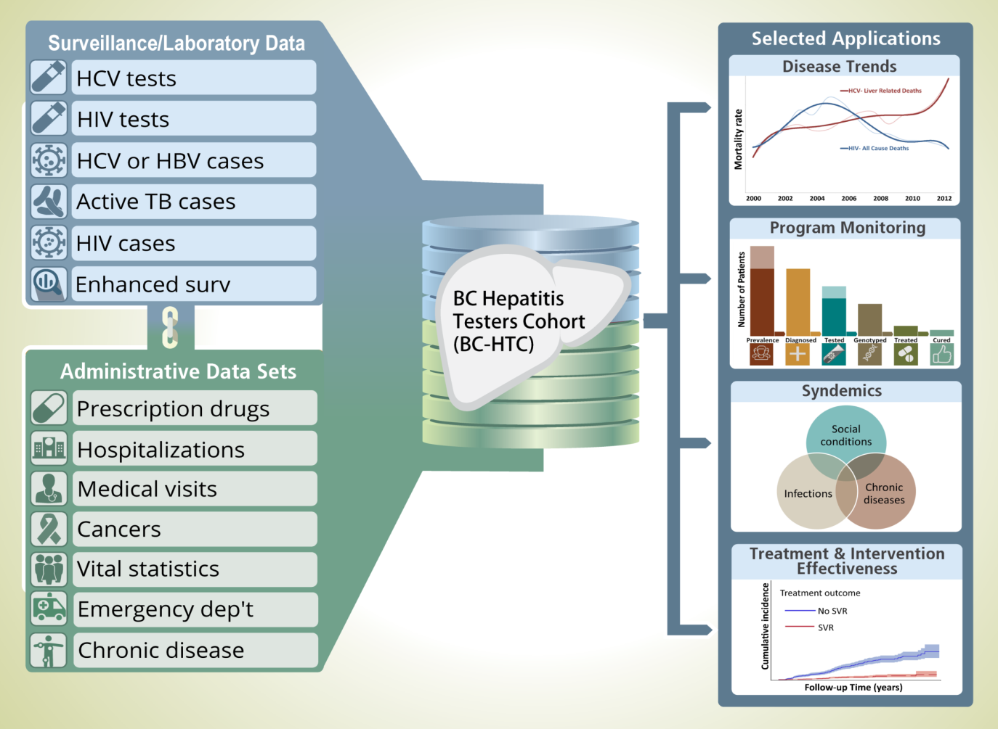

one-off data cuts
research vs evaluation
academically successful
informed policy
  Naveed Janjua
public awareness limited
~1.7 M people
~72k HepC infected

Slide 4
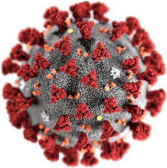

MoH/PHSA: cloud-based RT integrated data → PANDA
Enablers:
Crisis
$
Existing resource reallocation
PH mandate/PHO orders
Analytical data scaffold
BCCDC: RT COVID testing results (neg/pos), genomic variants, vaccine status, hosp/ICU - wastewater → makeshift (PLOVER)
RT info informed PH policy
Early vaccine efficacy/safety, delayed dosing, variant efficacy
Calibrate health measures to maintain system capacity

Slide 5
Real-time data for health policy
Population cohorts are ubiquitously used to assess outcomes/costs
  Cohort = people who share a common characteristic
  Currently cohorts are created as one-off processes
    Labour, data/approval intensive, not real-time (RT)
Most IT resources focus on acute care transactional systems and are poorly interoperable
Analytical systems designed to enable data driven HS planning, implementation, evaluation research are an afterthought

Slide 6

RT lab test results, genomic variants, vaccine status, hospitalization, and ICU data helped inform COVID public health policy
  Involved a patchwork of MoH, PHSA’s PANDA, BCCDC data systems
Illustrated the need for a shared ‘analytical data scaffold’ to tap into evolving data systems to assess multiple cohort outcomes simultaneously
  Otherwise, ‘one-off’ data systems are created to track each cohort, which is inefficient

Slide 7
Federal COVID funding was received to automate RT data integration for respiratory viruses, wastewater, and syphilis/HIV/HepC
UBC/BCCDC discussions about using shared RT lab/admin data to track multiple cohorts simultaneously
The term “Pan-system cohorts” was the coined – where a shared analytical data scaffold is used to track multiple cohorts simultaneously
  Data gaps could then be filled by collecting & linking minimum Purpose Specific Data (PSD)
Received UBC Strategic Innovation funding to generate proof-of-concept pan-system cohort model

Slide 8
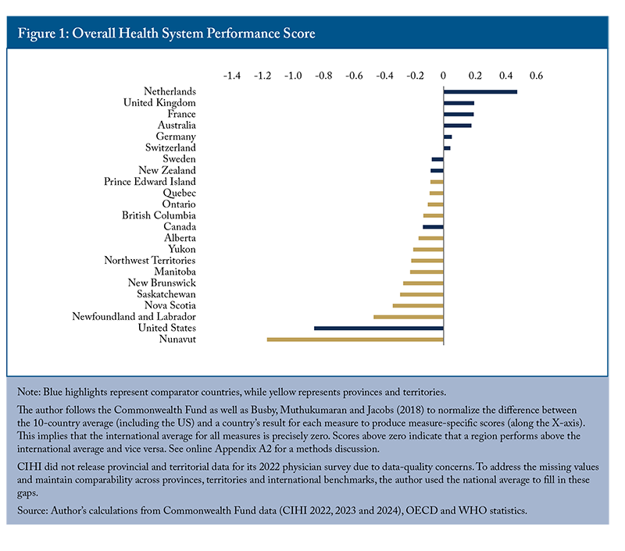
Canada ranked 9th in health system performance despite higher healthcare spending as a % of GDP (OECD 2023)
2nd last on access,
4th on the care process,
6th on administrative efficiency,
7th on equity,
6th on healthcare outcomes

Slide 9
Lessons from higher performing health systems:
Use data to drive “overall” prevention and care outcomes and costs
Jurisdiction | Key Features
S. Korea | Digital transformation in healthcare
Israel | Integrated healthcare systems and data-driven insights
NHS England | Population health management
US, Kaiser Permanente | Value-based care; integrating evidence-based care; high coordination across settings/teams

Slide 10
Seven Key Features of Good Integrated Health Systems with Efforts Ongoing in BC
Person-centered care: tailoring services to individual needs/preferences
Multidisciplinary: collaboration across professions and care settings
Single entry points and case management: simplifying access and coordination for patients with complex needs e.g., “virtual ward”
  Adapted from: https://wyoleg.gov/InterimCommittee/2019/10-201906132.WHOIntegrated-care-models-overview.pdf

Slide 11
Seven Key Features of Good Integrated Health Systems but largely lacking in BC
Shared information systems to facilitate communication and continuity across providers. Lack of shared analytical data scaffolds to use existing RT data for cohort tracking as data systems evolve
Performance metrics across the prevention, care, and treatment continuum - needed to optimize overall health outcomes and costs
Mechanisms to sustain ongoing dialogue on how upstream prevention +/-self management can impact downstream acute care outcomes and costs
Pooled or aligned budgets to facilitate rational resource allocation across prevention and care. Question: Can accurate and trusted RT data across prevention and acute care serve as a proxy for the lack of aligned budgets to support rational inter-sectoral resource allocations?
  Adapted from: https://wyoleg.gov/InterimCommittee/2019/10-201906132.WHOIntegrated-care-models-overview.pdf

Slide 12
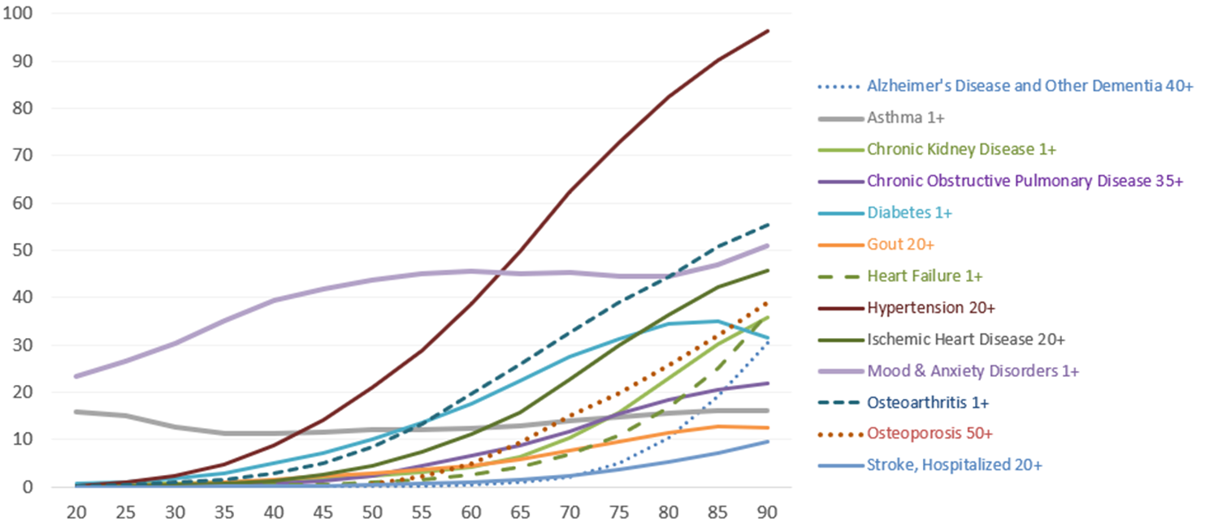
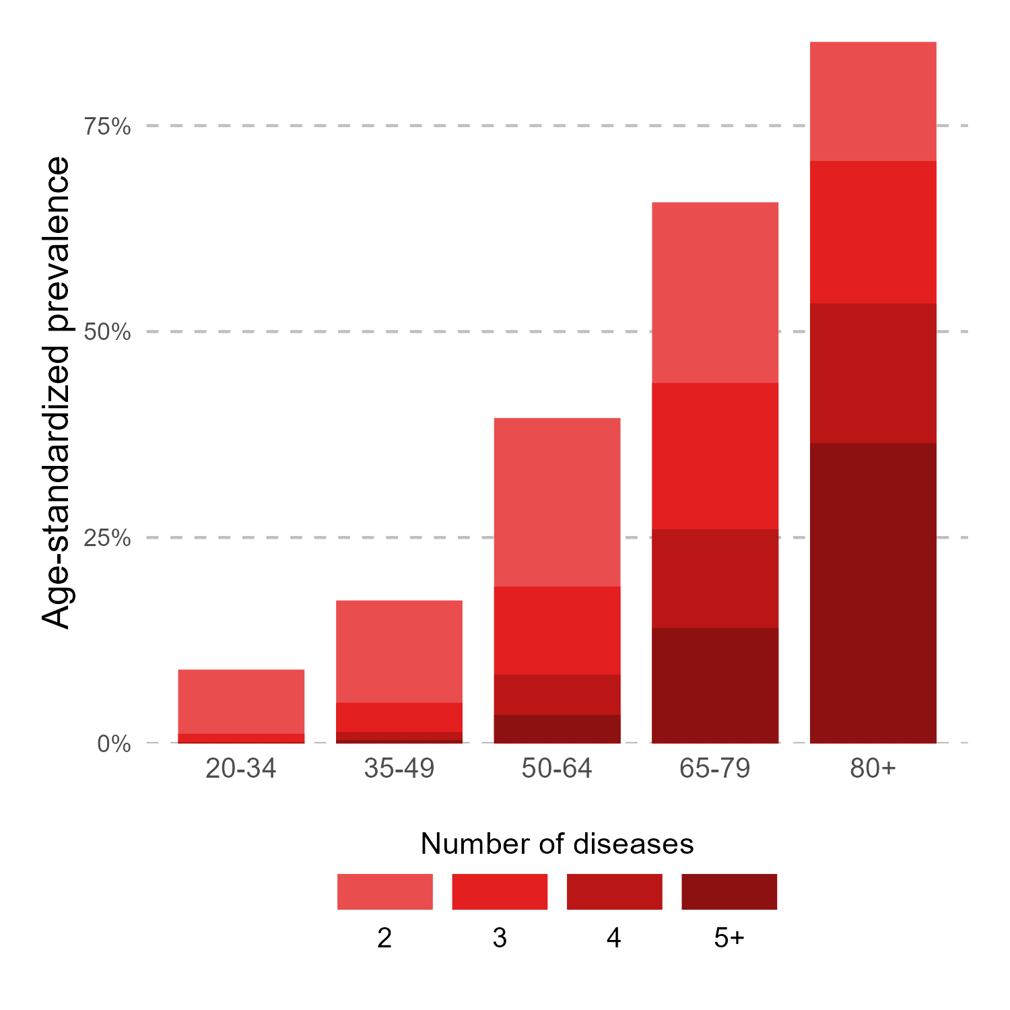
Health system sustainability is a huge challenge - major cost drivers being chronic co-morbid illnesses, therapeutics, technology, and an aging population
BC, 2019/20
Prevalence %
Hypertension
Mood & Anxiety
Age

Slide 13
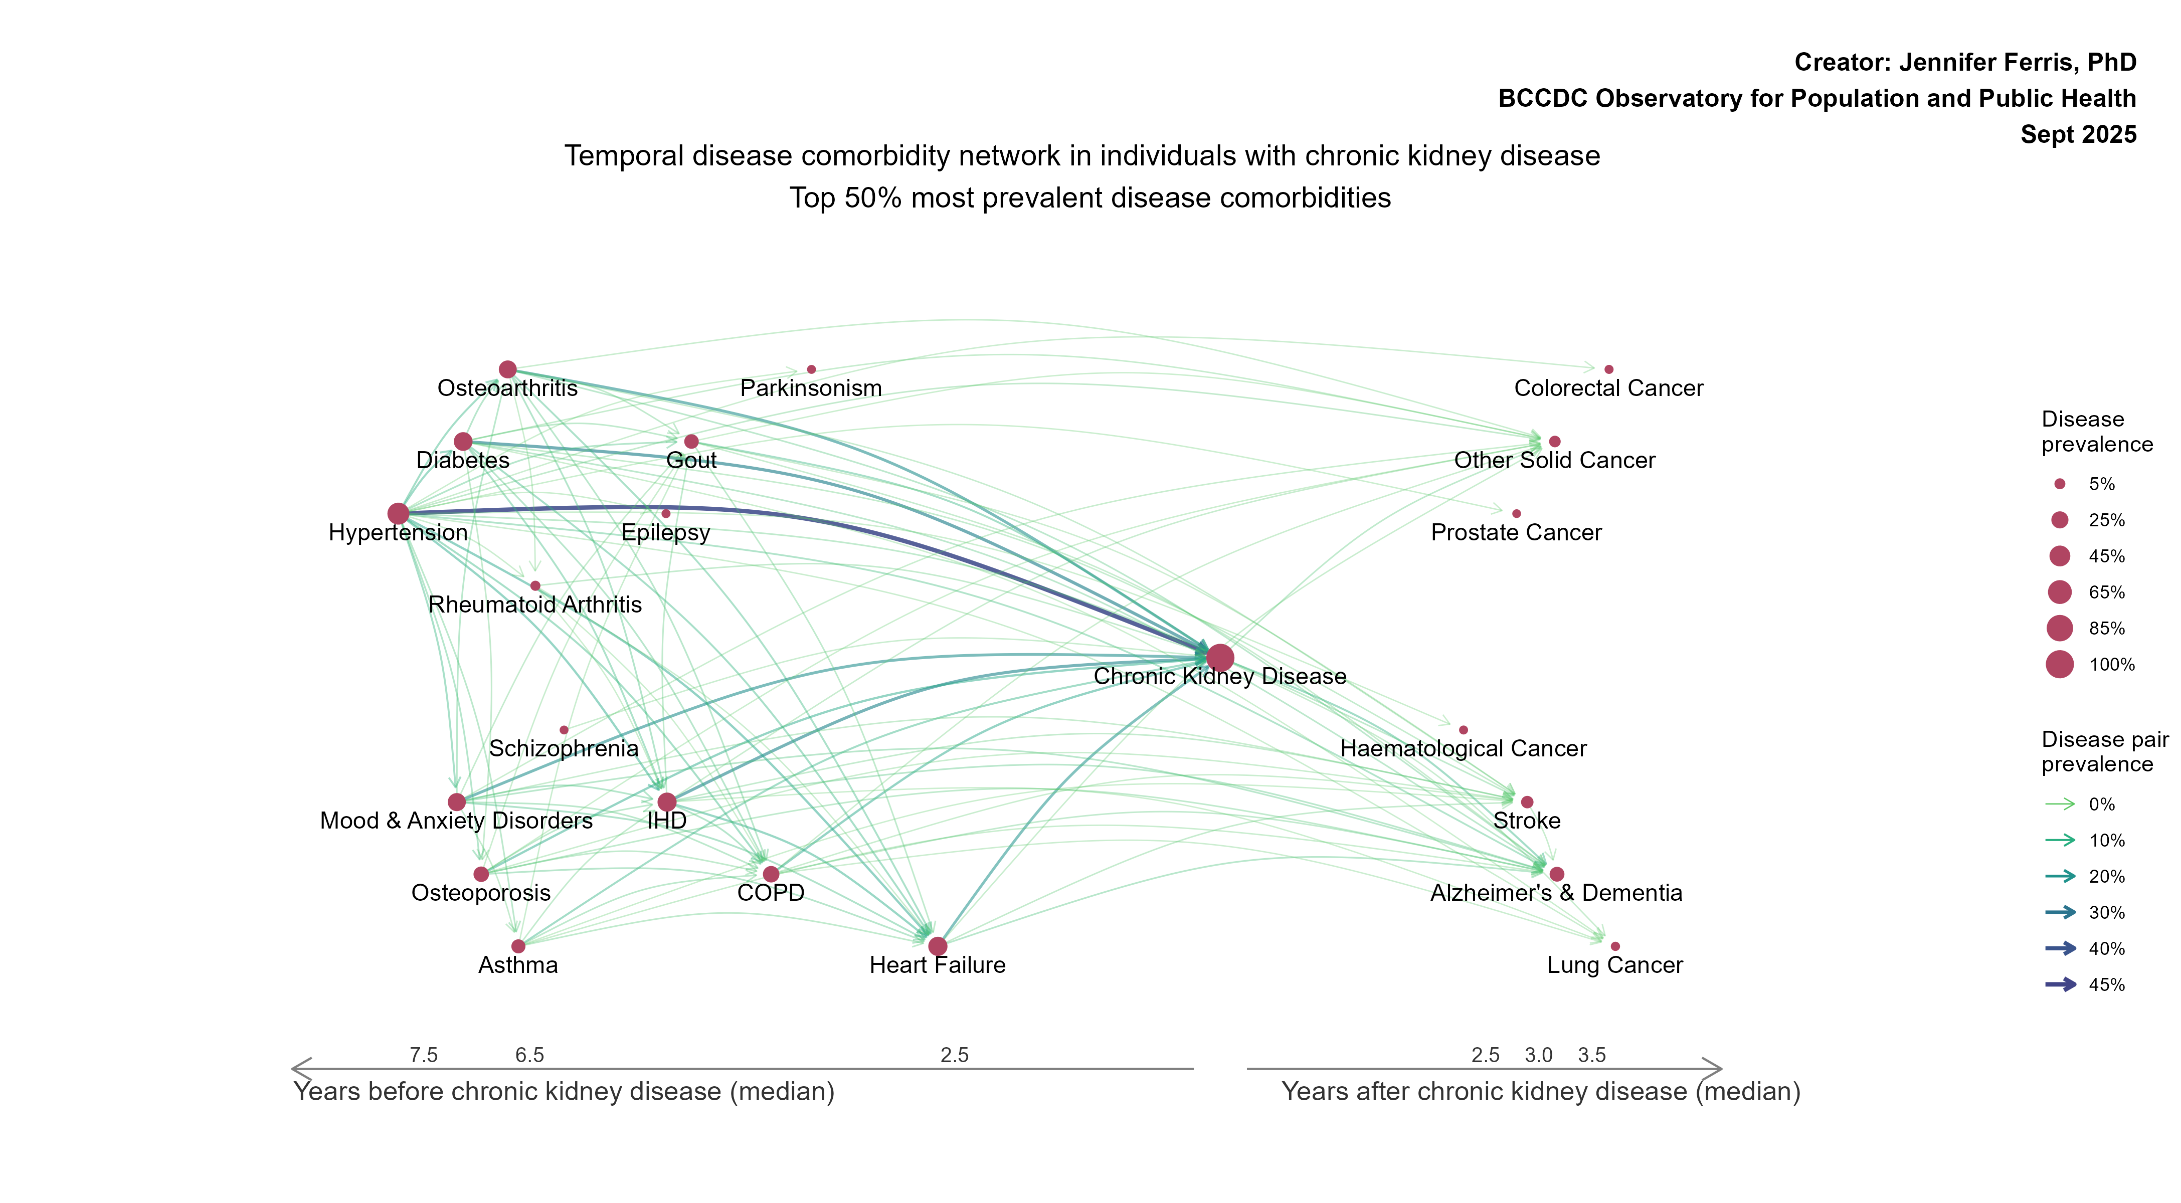
Using Chronic Kidney Disease as an endpoint, underlying risks evolve over years, yet the system tends to focus on downstream care and treatment
effective
efficient
Notes:
Some things to note:
This analysis was performed on a population sample with a minimum of 10 years of continuous MSP registration between 2001/02 and 2019/20. For this plot, all individuals had an incident CKD record between 2001/02 and 2019/20
This plot is only the top 50% most prevalent disease comorbidities for individuals with CKD.
The x-axis is the median time (in years) between the incident comorbidity case record and the incident CKD case record
The size of disease nodes represents the prevalence of each disease comorbidity in individuals with CKD, and the links between diseases represents the prevalence of each disease pair in individuals with CKD (this lets you look at diseases paired with CKD andwith each other, i.e. how many individuals with CKD have both hypertension and diabetes, and what is the typical time between onset for each?

Slide 14
Using Information-Driven Technologies in Health Care Requires an Ecosystem-Based Approach
Adopting a system-wide perspective: technology needs to contextualized for users,
Need a shared ecosystem value proposition: e.g., aspiration to use data to improve prevention & acute care value (cost/quality)
Need to grow ecosystem leadership: identify inter-sectoral leaders and create spaces for ecosystem work,
Grow senior-level oversight and meso-level ecosystem leadership: balance centralization vs decentralization,
Create a pathway for evolving a permanent learning ecosystem
Reed et al. J Med Internet Res 2025;27:e56836

Slide 15
Value of information for decision making?
Evidence from real-world data is increasingly important to improve clinical & health system practice
For evidence adoption:
  high quality
  contextually integrated → scientific and political
  coupled to clinician or relevant stakeholder judgment
Pfaffenlehner et al. BMC Medical Research Methodology (2025)

Slide 16
What is required?
Create metrics across prevention, care, and treatment to support planning, implementation, and evaluation of services
Sustain dialogue across prevention and acute care to learn how to optimize upstream prevention to improve downstream outcomes and costs
Develop a pan-system cohort approach to use shared data from existing systems to assess if high quality, contextualized data can serve as proxy for the lack of aligned or shared inter-sectoral budgets
  Research and operations need similar data to measure system efficiency and effectiveness to support planning, implementation, and evaluation

Slide 17
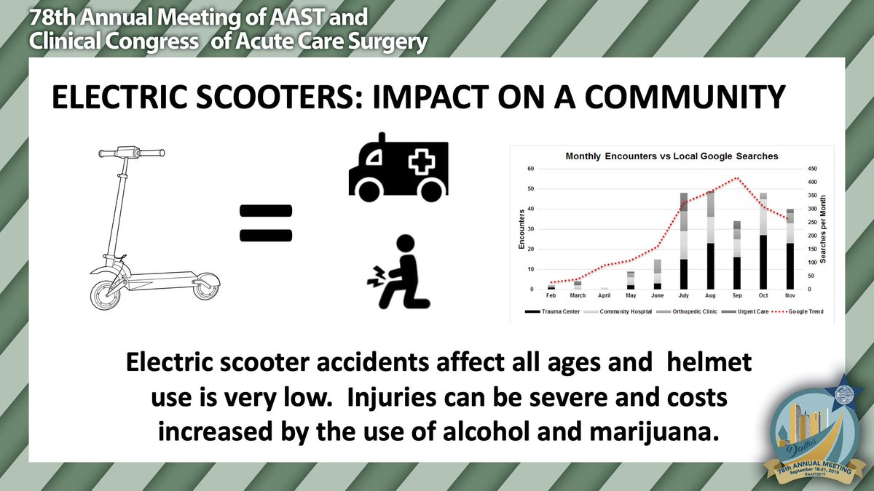

Electric Scooters

Slide 18


Colon Cancer
2023, BC Cancer Colon Screening Program - steady increase in FIT uptake
58.1% of age-eligible pop (50–74) up-to-date
    FIT within the past 30 m or a colonoscopy within 10 yrs
Retention Rate: 56% to 64%, improved - kits mailed directly
Positive Results: 2023 8.43% +ve
Missing 40%?
More younger people developing colon cancer?
Care & Treatment capacity
colonoscopy?
surgical?
pathology?
molecular classification?
therapeutic treatments
regional disparities
FIT
(Fecal Immuno-chemical Test)

Slide 19
Laboratories and their data add value
100% of breast cancer cases require sophisticated pathology
Optimizing screening uptake for breast cancer, mammography, who remains unscreened? How are outcomes impacted by improved treatment?
Optimizing genomic screening e.g., BRCA1 or BRCA2 for breast, ovarian cancer, prostate cancer risk stratification…
HPV vaccination vs HPV screening for cervix cancer, how many HPV tests are needed in a lifetime, utility of HPV testing in a vaccinated population?
Using available data to plan, implement, evaluate cost-effective outcomes – laboratory testing data are critical elements that need to be connected across the prevention, care and treatment continuum!

Slide 20
Conclusions and Visual Summary

Slide 21
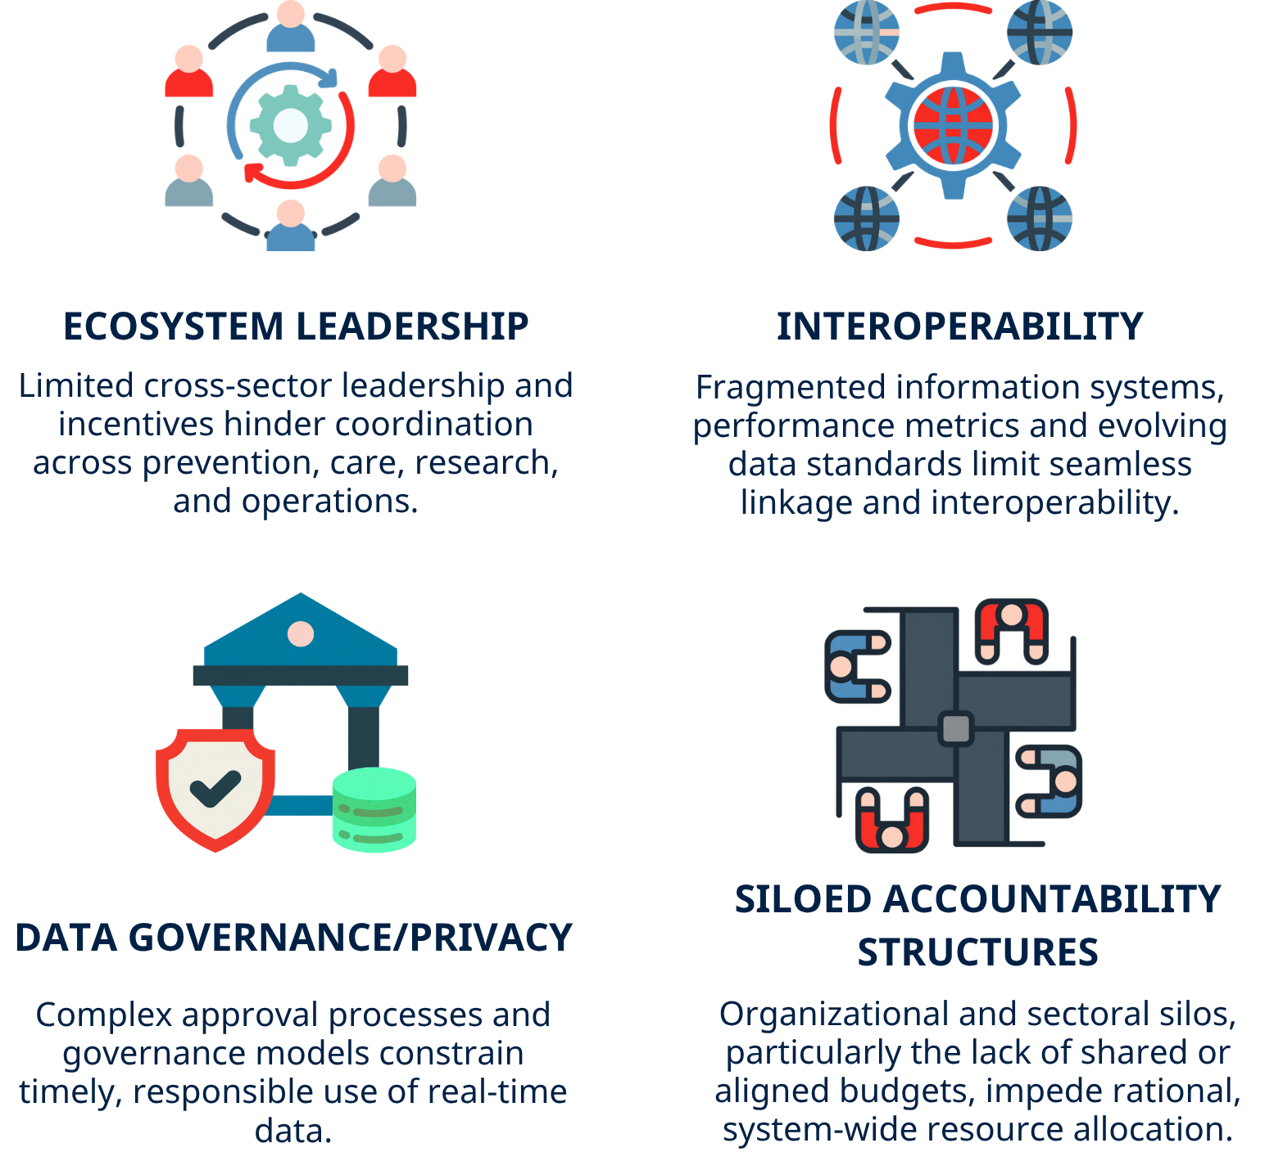
Key challenges in proof-of-concept examples

Slide 22
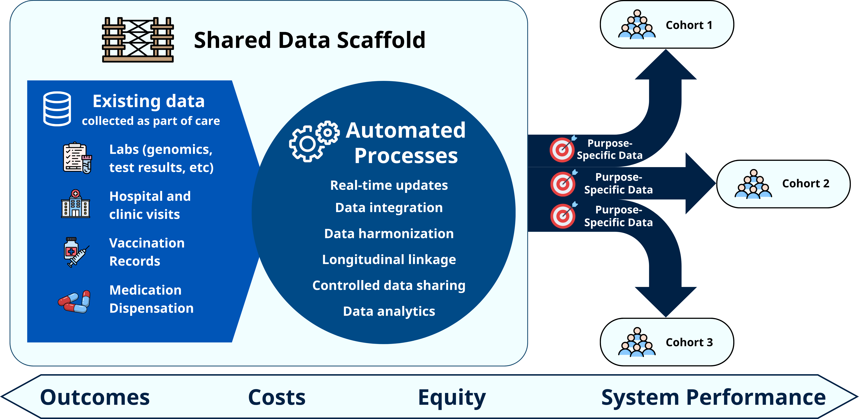
Pan‑system cohort framework - how a shared analytical scaffold enables simultaneous real‑time cohort tracking across prevention, care, and treatment using existing health system data.

Slide 23
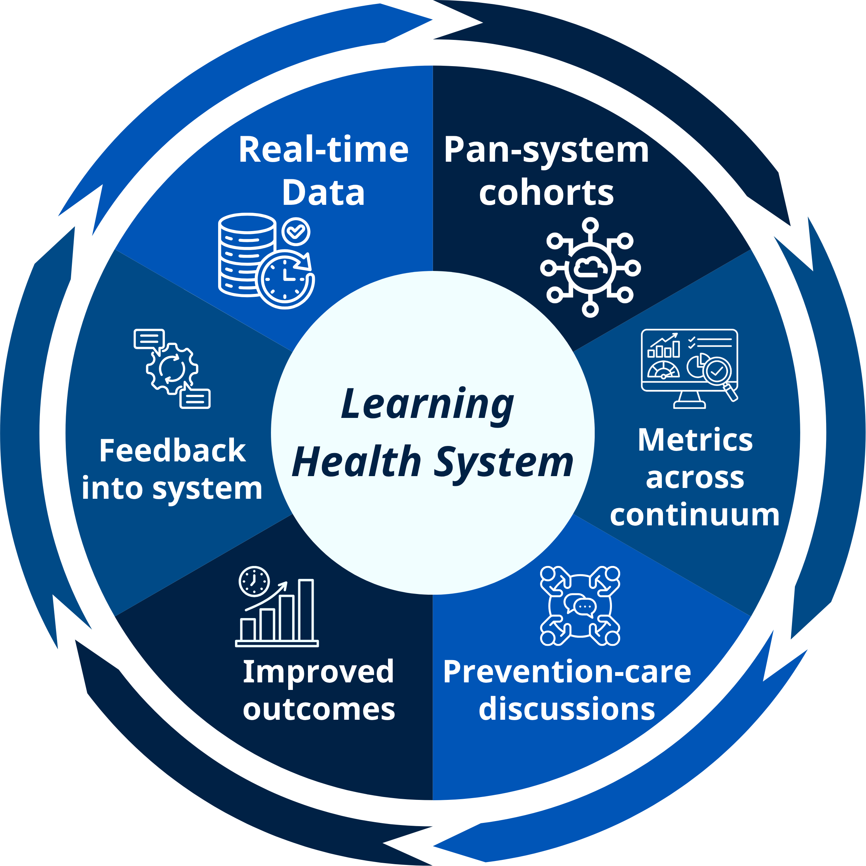
Learning health system feedback loop

